Slide 1

KONGUNADU COLLEGE OF ENGINEERING AND TECHNOLOGY
(AUTONOMOUS)
Tholurpatti (P.O), Thottiam –T.K, Trichy – 621 215.
(Approved by AICTE, New Delhi & Affiliated to Anna University, Chennai, Accredited by NBA (CSE, ECE , EEE & MECH), Accredited by NACC , Recognized by UGC with 2 (f) & 12(B) and ISO 9001:2015 certified Institution)
DEPARTMENT OF ELECTRONICS AND COMMUNICATION ENGINEERING
20EC506L – MINI PROJECT – I
END SEMESTER VIVA VOCE
REAL TIME IMAGE BASED SMART VOTING SYSTEM
ACADEMIC YEAR: 2023-2024 BATCH NO: 19 YEAR/SEMESTER: III/V
Presented by
SIVAMURUGAN G (621321106098)
TAMILSELVAN S (621321106109)
VETRIVEL K (621321106115)
Guided by Dr.B.UMARANI,M.E.,Ph.D., Professor/ECE,
KNCET.
1

Slide 2
CONTENTS
Objectives
Abstract
Introduction
Literature Review
Problem Identification
Existing System
Proposed System
Software Requirements
Results and Discussion
Conclusion
References
2

Slide 3
OBJECTIVES
This project make voting more accessible to a wider range of voters, including those with disabilities, by providing user-friendly interfaces and options for remote voting
Allow voters to cast their votes from various locations, reducing the need for physical presence at polling stations and increasing participation.
3

Slide 4
ABSTRACT
The purpose of creating a Real-Time Image Based Smart Voting system is to improve the democratic voting process in several ways.
This system ensures accuracy and eliminates the need for traditional paper ballots, enhancing the efficiency and transparency of elections.
Real-time monitoring and secure data storage contribute to the integrity of election results, fostering trust in the electoral system.
4

Slide 5
INTRODUCTION
An Image-Based Smart Voting System employs visual data, such as image processing, to enhance the voting process.
This technology aims to improve accuracy, prevent illegal voting, and streamline the voting experience by utilizing barcode for voter identification and verification.
It often integrates advanced algorithms to ensure the security and integrity of the voting system while maintaining user privacy.
5

Slide 6
LITERATURE REVIEW
S.No | Title | Author & Year | Journal/Reference Name | Remarks
1. | Transparent voting system using blockchain | V.Anitha & 2020 | IEEE journal | In countries where traditional physical voting with gameable securities is used, increasing the likelihood of rigged elections, the goal of this paper is to create a decentralized transparent voting and analysis system that can be implemented with blockchain technology.
2. | A blockchain-based e-voting system using bio hash | S.Linta & 2022 | IRE journal | Voting is a fundamental democratic activity. Many experts believe that paper balloting is the only appropriate method to ensure everyone’s right to vote. But this method is prone to errors and abuse.
3.
6

Slide 7
LITERATURE REVIEW
S.No | Title | Author & Year | Journal/Reference Name | Remarks
3. | A voting-based scheme and cross-datasets analysis | Pedro Silva & 2020 | IEEE journal | Early detection and diagnosis are critical factors to control the COVID-19 spreading. A number of deep learning-based methodologies have been recently proposed for COVID-19 screening
4. | Online Voting System Security based on Cryptography | Warish Patel & 2021 | IEEE journal | Cryptography is the study of protecting data. It has been used as a means of safe communication between people and governmental organizations. Today, cryptography is the foundation of advanced security.
.
7

Slide 8
PROBLEM IDENTIFICATION
In this section we consider the definition of the problem of button issue through a voting machine’s.
We also known the voting through a voting machine and wait for a long time to vote in queue. This problem’s are overcome through this project.
8

Slide 9
EXISTING SYSTEM
The Button System is a technology by which a election is able to recognize the people’s voting on the polling centers . This is an easy way to identify the people division of voting and also help to monitor how many percentage of people voting in this particular election. Using the system to deliver the result as soon as possible.
9

Slide 10
PROPOSED SYSTEM
User
Barcode- VoterID
Scan the Voter ID
Verification
Authenticated/
Unauthenticated
Display
Information
10

Slide 11
DESCRIPTION
The every user having a own Barcode in our voter Id’s.
Show our barcode infront of the webcam, the webcam scan our voter barcode.
It will check the user details and store in worksheet.
If the details are approved successfully (permission to vote).
If the details are already exist (should not be allowed to vote)
11

Slide 12
SOFTWARE REQUIREMENTS
Pycharm Community Edition
Python language
12

Slide 13
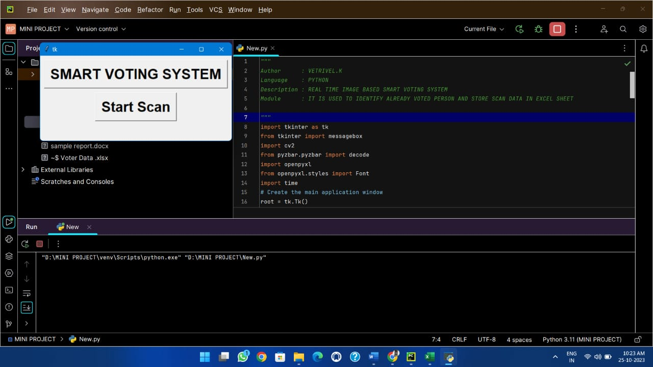
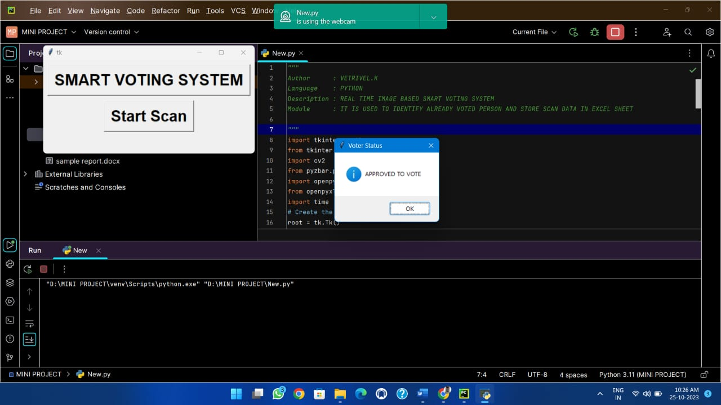
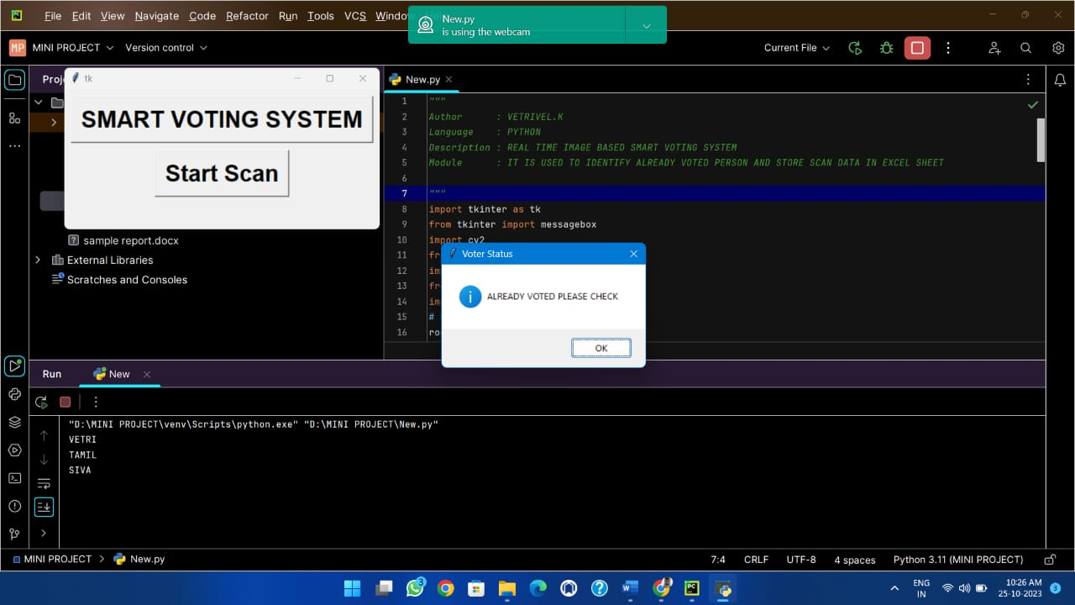
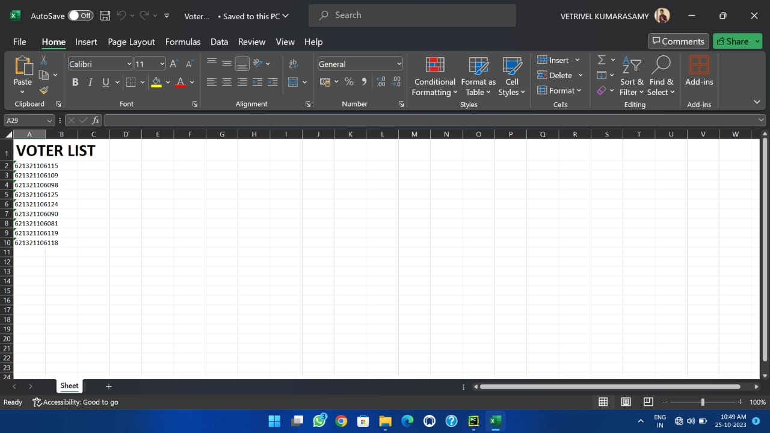
RESULTS AND DISCUSSION
13

Slide 14
CONCLUSION
In conclusion, the implementation of a real-time image-based smart voting system marks a pivotal advancement in electoral processes, offering a promising blend of convenience, security, and accuracy.
Moreover, the real-time aspect of this system facilitates prompt tabulation and reporting of results, enhancing transparency and trust in the electoral process.
14

Slide 15
REFERENCES
Alrebdi, Norah, Alabdulatif, Abdulatif, Iwendi, Celestine, Lian, and Zhuotao, (2022). ‘Svbe:searchable and verifiable blockchain-based electronic medical records system’, Scientific Reports, Vol.12, Issue.1, pp.1–11.
Mykletun, Einar, Narasimha, Maithili, Tsudik and Gene (2003). ‘Providing authentication and integrity in outsourced databases using merkle hash trees’, UCI-SCONCE Technical Report. Pp.112-120.
Yi Haibo (2019) ‘Securing e-voting based on blockchain in p2p network’, EURASIP Journal on Wireless Communications and Networking, Pp.1–9.
Zhang, W., Yuan, Y., Hu, Y., Huang, S., Cao, S., Chopra, A and Huang, S., (2018) ‘A privacy preserving voting protocol on blockchain’, pp. 401–408.
15

Slide 16
CONTD.,
5. Syed, Shahram Najam, Shaikh, Aamir, Naqvi and Shabbar (2018) ‘A novel hybrid biometric electronic voting system: Integrating finger print and face recognition’, Mehran University Research Journal of Engineering and Technology, Vol.no.37, Issue., Pp. 37-48.
6. Uddin, M.A., Stranieri, A., Gondal, I and Balasubramanian, V (2019).‘A decentralized patient agent controlled blockchain for remote patient monitoring’, International Conference on Wireless and Mobile Computing, Networking and Communications (WiMob),pp. 1–8.
16

Slide 17
THANK YOU
17

